Slide 1


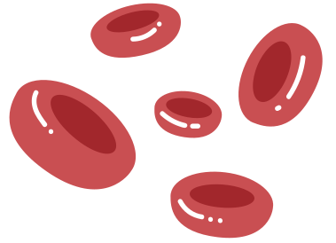

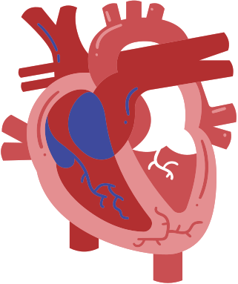
The Circulatory System
The role of the heart, blood and blood vessels

Slide 2


Let’s have a quick poll!
What is your pulse rate?
To check your pulse, place the tips of your index and middle finger on your wrist.
Feel your pulse and count the beats for 15 seconds. Then, multiply that number by four to find out how many times your heart beats in one minute.
Where does this pulse come from?
Tip:
Double-click to customize this poll or quiz, or go to the Elements Tab for more options!
2

Slide 3


Today, you will...
Name and describe the main parts of the human circulatory system.
Describe the role of the heart, blood, and blood vessels.
3

Slide 4


The Human Circulatory System
Function
Main Parts
To transport blood, oxygen, and nutrients to the body
Has three main parts: the heart, blood vessels, and blood
4

Slide 5
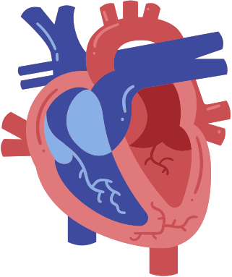

The Heart
right atrium
left atrium
It works as a pump to move the blood around the body.
It has four chambers—two atria (upper chambers) and two ventricles (lower chambers).
right ventricle
left ventricle
5

Slide 6



The Heart
Let’s examine how blood flows through the heart.
1
from upper body
The right atrium takes in blood carrying carbon dioxide.
to left lung
1
2
Blood is squeezed down into the right ventricle and taken to the lungs, where oxygen replaces carbon dioxide.
2
6

Slide 7

The Heart
Let’s examine how blood flows through the heart.
to body
3
Oxygen-carrying blood from the lungs enters the left atrium.
3
from left lung
4
Blood is pumped into the left ventricle and starts its journey again throughout the body.
4
7

Slide 8


Lesson Check: The Heart
Can you explain how blood flows through the heart with a partner,
even without the diagram of the heart?
Try explaining the process to your peer without referring to your notes.
8

Slide 9
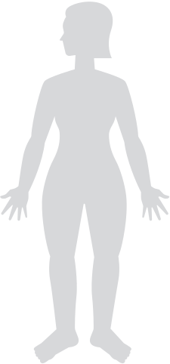
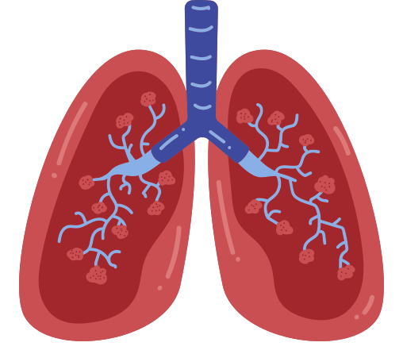

ANSWER KEY
Lesson Check: The Heart
Right Atrium
Left Atrium
lungs
body
Right Ventricle
Left Ventricle
Can you explain how blood flows through the heart with a partner, even without the diagram of the heart?
Shown is a sample diagram of how blood flows through the heart.
lungs
body
9

Slide 10
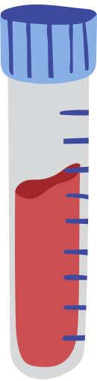

Blood
It is a special fluid
primarily contained within
the blood vessels.
It has four main components—red blood cells, white blood cells, platelets, and plasma.
10

Slide 11




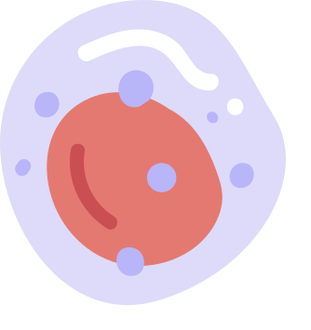

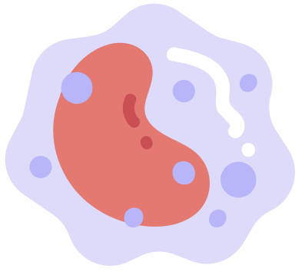
Blood
Our blood has four main components:
Red Blood Cells
Platelets
carry oxygen, nutrients and wastes
gather at the site of injury and help the clotting process
Plasma
White Blood Cells
straw-colored liquid where the other components float in
fight diseases and protect the body from infection
11

Slide 12

Lesson Check: Blood components
Let’s try this!
12

Slide 13
ANSWER KEY
Lesson Check: Blood components
The primary function of platelets is to stop
and prevent bleeding by forming clots.
Once a blood vessel is damaged, it sends out signals to attract platelets to the site. These tiny blood cells rush to the site and form a plug that acts as a temporary barrier to prevent further bleeding.
13

Slide 14
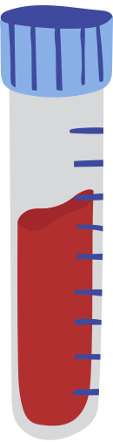
Blood
plasma
When someone has a blood test, a small amount of blood is taken and kept in a tube for testing.
white blood cells and platelets
To closely examine it, blood undergoes component separation. One common method involves spinning it at very high speeds
in a centrifuge.
red blood cells
Blood is divided into its components, with the heaviest parts at the bottom.
14

Slide 15

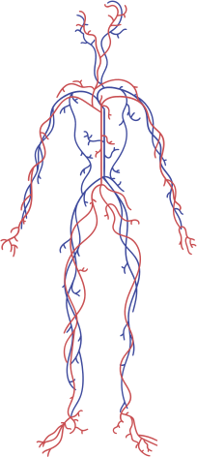
Blood Vessels
These are tubes or channels that
carry blood throughout our body.
There are three types of blood vessels—veins, arteries and capillaries.
Each one differs in size and structure.
15

Slide 16


Blood Vessels
Let’s take a closer look at the three types of blood vessels:
Artery
It has the thickest wall of all three, allowing it to withstand the high pressure created by the heart.
It has the thinnest wall to allow substances such as oxygen and sugars to pass through its wall—into or out of the blood.
Capillary
It is less muscular and stretchy than an artery, so blood moves through it with low pressure. It also has a special valve that helps blood go only one way.
Vein
16

Slide 17

Blood Vessels
Each type of blood vessel has a unique role in the circulatory system.
Artery
Capillary
Vein
Carries blood away from the heart
Assists in the exchange of substances between the blood and tissues
Carries blood back towards the heart
TIP
Remember ‘A’ for ‘artery’ and ‘away’ from the heart!
17

Slide 18
Let’s try this!
Lesson Check: Sickle Cell Disease
Sickle cell disease (SCD) is an inherited blood disorder. People with SCD have red blood cells that become hard and sticky, forming
a C-shaped blood cell instead of the healthy disc-shaped one.
18

Slide 19

ANSWER KEY
Lesson Check: Sickle Cell Disease
Considering what you learned about blood and blood vessels, how does this shape affect blood flow in the circulatory system?
The irregular shape of the sickle-shaped blood cell
makes it easy to clog and block the blood flow.
This can cause pain and other serious infections.
19

Slide 20
A Recap
The circulatory system delivers oxygen and nutrients to the body, while also removing wastes.
Heart
Blood
Blood Vessels
Muscular organ that has four chambers
Pumps blood around the body
Has four components: plasma, red blood cell, white blood cell, and platelets
Carries oxygen,
nutrients and wastes
Has three types: arteries, veins and capillaries
Serve as channels
for the blood
20

Slide 21
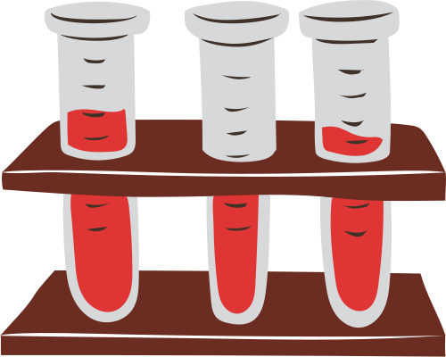
A Day in the Life of a Red Blood Cell
Write a story as though you are
a red blood cell.
Some guide questions you can use are:
  What do you look like?
  What is your job?
  Where are you found?
  Where do you travel from and to?
21

Slide 22


Share this template
Follow the steps below:
Click the Share button on the upper right corner of the editor.
Select
Public view link.
Don’t forget to delete or hide this page before presenting.

Slide 23

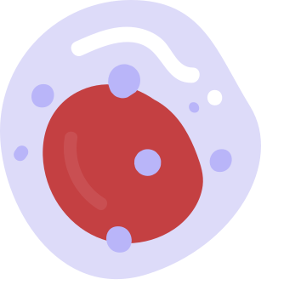
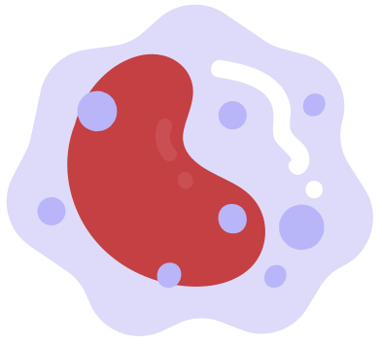











Resource Page
Use these icons and illustrations in your Canva Presentation. Happy designing!
Don't forget to delete this page before presenting.

Slide 24
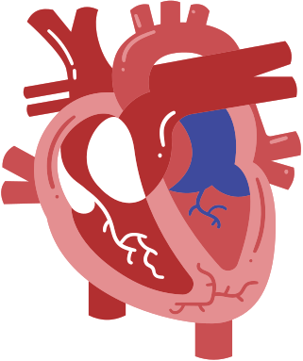

  Try this background for online class.
  *Please delete this section before downloading.

Slide 25

B
for blur
C
for confetti
Press these keys while in Present mode!
D
for a drumroll
M
for mic drop
O
for bubbles
Q
for quiet
Any number from 0-9 for a timer
U
for unveil

